Slide 1
Fundamentals of Blockchain Technology
CST 428 BLOCK CHAIN TECHNOLOGIES
S8 CSE – ELECTIVE
MODULE – 2

Slide 2
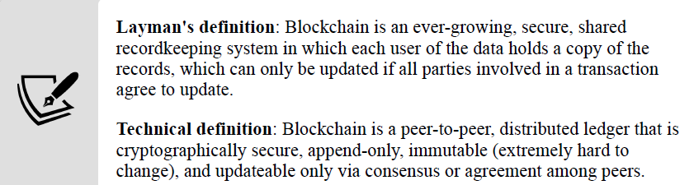
Blockchain Definition
P2P - there is no central controller in the network, and all participants (nodes) talk to each other directly
allows transactions to be conducted directly among the peers without third-party involvement, such as by a bank

Slide 3
Blockchain Definition
Distributed Ledger - ledger is spread across the network among all peers in the network, and each peer holds a copy of the complete Ledger
Append-only
data can only be added to the blockchain in time sequential order
almost impossible to change data in block (immutable)

Slide 4
Blockchain Definition
updateable only via consensus - mutual agreement
Blockchain Demo (andersbrownworth.com)

Slide 5
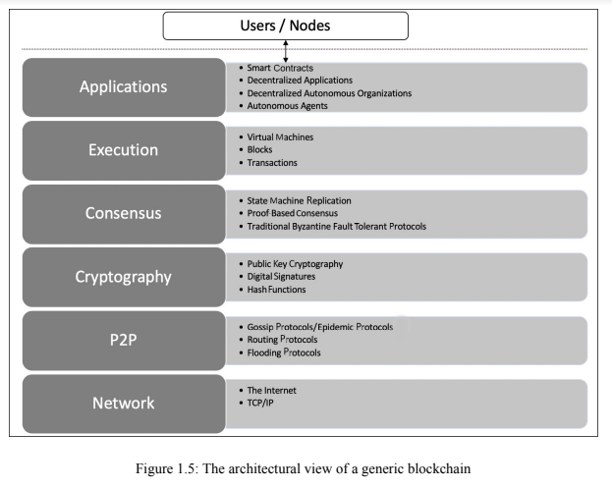
contains all sorts of various user level agents and programs that operate on the blockchain
provides executions services on the blockchain and performs operations such as value transfer, smart contract
execution, and block generation
Ensures agreement among different participants
Ensures security of block chain
Information propagation layer
Basic communication layer

Slide 6
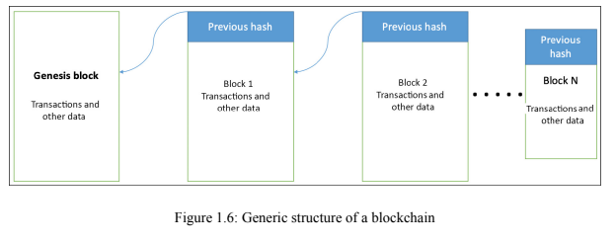
Blockchain - Generic Elements
first block in the blockchain that is hardcoded at the time the blockchain was first started
dependent on the type and design of a blockchain

Slide 7
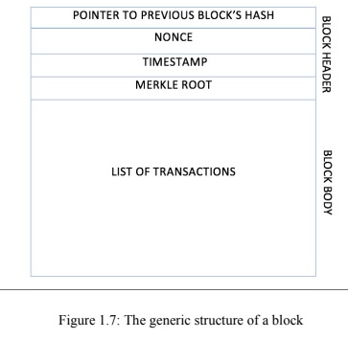
Blockchain - Generic Elements
a number that is generated and used only once
creation time of the block
hash of all of the nodes of a Merkle tree
record of an event, for example, the event of transferring cash from a sender's account to a beneficiary's account

Slide 8
Blockchain - Generic Elements
Address - unique identifiers used in a blockchain transaction to denote senders and recipients usually a public key or derived from a public key
Transaction: fundamental unit of a blockchain represents a transfer of value from one address to another
Block: A block is composed of multiple transactions and other elements, such as the previous block hash (hash pointer), timestamp,and nonce
Peer-to-peer network: network topology wherein all peers can communicate with each
other and send and receive messages
Virtual machine: allows Turing complete code to be run on a blockchain as smart contracts whereas a transaction script is limited in its operation. Ethereum Virtual Machine (EVM) and
Chain Virtual Machine (CVM)

Slide 9
Blockchain - Generic Elements
State machine: A blockchain can be viewed as a state transition mechanism whereby a state is modified from its initial form to the next one by nodes on the blockchain network as a result of transaction execution
Smart contracts: programs run on top of the blockchain and encapsulate the business logic to be executed when certain conditions are met. These programs are enforceable and automatically executable
Node: performs various functions depending on the role that it takes on and can propose and validate transactions and perform mining to facilitate consensus and secure the blockchain

Slide 10
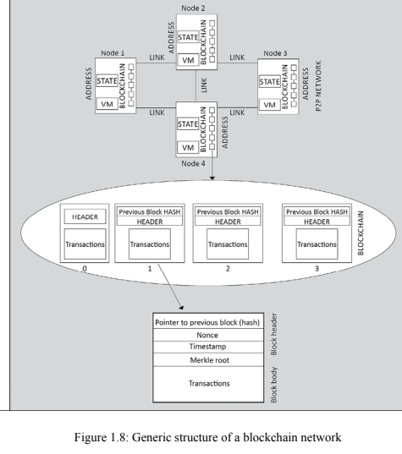

Slide 11
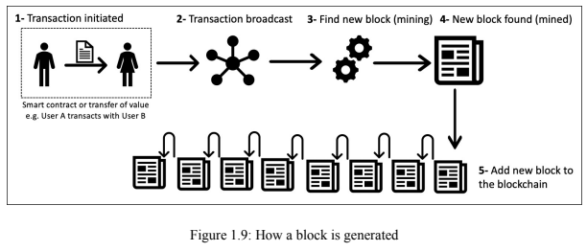
How blockchain works?

Slide 12
Benefits and features of blockchain
Decentralization: There is no need for a trusted third party or intermediary to validate
transactions; instead, a consensus mechanism is used to agree on the validity of transactions
Transparency and trust: As blockchains are shared, this allows the system to be transparent
Immutability: Once the data has been written to the blockchain, it is extremely difficult to change it back
High availability: As the system is based on thousands of nodes in a peer-to-peer network, and the data is replicated and updated on every node, the system becomes highly available
Highly secure: All transactions on a blockchain are cryptographically secured and thus provide network integrity. Any transactions posted from the nodes on the blockchain are verified based on a
predetermined set of rules. Only valid transactions are selected for inclusion in a block

Slide 13
Benefits and features of blockchain
Simplification of current paradigms: blockchain can serve as a single shared ledger among many interested parties, this can result in simplifying the model by reducing the complexity of managing the separate systems maintained by each entity
Faster dealings: Blockchain does not require a lengthy process of verification, reconciliation, and clearance because a single version of agreed-upon data is already available on a shared ledger
between financial organizations
Cost-saving: As no trusted third party or clearing house is required in the blockchain model, this can massively eliminate overhead costs in the form of the fees, which are paid to such parties
Platform for smart contracts: A blockchain is a platform on which programs can run that execute business logic on behalf of the users. It is available on newer blockchain platforms such as Ethereum and MultiChain, but not on Bitcoin

Slide 14
Benefits and features of blockchain
Smart property: It is possible to link a digital or physical asset to the blockchain in such a secure and precise manner that it cannot be claimed by anyone else. You are in full control of your asset, and it cannot be double-spent or double-owned. Compare this with a digital music file, for example, which can be copied many times without any controls. While it is true that many Digital Rights Management (DRM) schemes are being used currently along with copyright laws, none of them are enforceable in the way a blockchain-based DRM can be

Slide 15
Limitations of blockchain
Scalability: Currently, blockchain networks are not as scalable
Adoption: there is still a long way to go before the mass adoption of this technology
Regulation: Due to its decentralized nature, regulation is almost impossible on blockchain. Traditionally, due to the existence of regulatory authorities, consumers have a certain level of confidence that if something goes wrong they can hold someone accountable
Relatively immature technology: blockchain is still a new technology and requires a lot of research to achieve maturity
Privacy and confidentiality: Privacy is a concern on public blockchains such as Bitcoin where everyone can see every single transaction. This transparency is not desirable in many industries such as the financial, law, or medical sectors

Slide 16
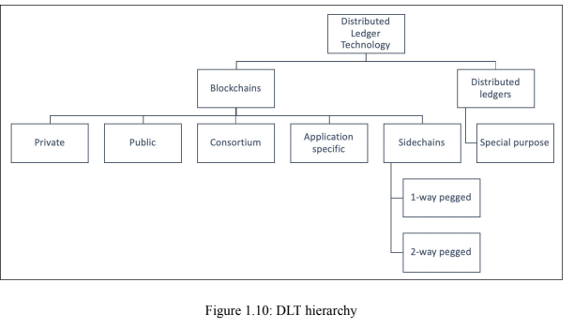
Types of blockchain
known as "pegged sidechains"
coins can be moved from one blockchain to another and then back again
Typical uses include the creation of new altcoins (alternative
cryptocurrencies) whereby coins are burnt as a proof of an adequate stake
open only to a consortium or group of individuals or organizations
Kadena and Quorum
not owned by anyone
open to the public and anyone can participate as a node in the decision making process. Users may or may not be rewarded for their participation
Bitcoin and Ethereum are both considered public blockchains

Slide 17
Types of blockchain
Permissioned ledger : blockchain where participants of the network are already known and trusted and do not need to use a distributed consensus mechanism; instead, an agreement protocol is used to maintain a shared version of the truth about the state of the records on the Blockchain
Shared ledger: any application or database that is shared by the public or a consortium. Generally, all blockchains fall into the category of a shared ledger.
Fully private and proprietary blockchains

Slide 18
Types of blockchain
Tokenized blockchains: standard blockchains that generate cryptocurrency as a result of a consensus process via mining or initial distribution. Bitcoin and Ethereum are prime examples
Tokenless blockchains : do not have the basic unit for the transfer of value. However, they are still valuable in situations where there is no need to transfer value between nodes and only
the sharing of data among various trusted parties is required.

Slide 19
Consensus
backbone of a blockchain
provides the decentralization of control through an optional process known as mining
choice of the consensus algorithm is governed by the type of blockchain in use
process of achieving agreement between distrusting nodes on the final state of data

Slide 20
Consensus
a set of steps that are taken by most or all nodes in a blockchain to agree on a proposed state or value
Requirements:
Agreement: All honest nodes decide on the same value
Integrity: no node can make the decision more than once in a single consensus cycle

Slide 21
Consensus
Requirements:
Validity: The value agreed upon by all honest nodes must be the same as the initial value proposed by at least one honest node
Fault tolerant: The consensus algorithm should be able to run correctly in the presence of faulty or malicious nodes
Termination: All honest nodes terminate the execution of the consensus process and eventually reach a decision

Slide 22
Types of consensus
Proof-based consensus mechanisms:
nodes to compete in a leader-election lottery, and the node that wins proposes the final value
Eg. miner who solves the computational puzzle as proof of computational effort expended wins the right to add the next block to the blockchain

Slide 23
Types of consensus
Traditional fault tolerance-based:
relies on a simple scheme of nodes that publish and verify signed messages in a number of phases
Eventually, when a certain number of messages are received over a period of rounds (phases), then an agreement is reached

Slide 24
Types of consensus
Traditional fault tolerance-based:
Two types of faults
Fail-stop faults: node merely crashed
Paxos and RAFT protocol are used to deal
Byzantine faults: faulty node exhibits malicious or inconsistent behavior arbitrarily
Difficult to handle
Byzantine Fault Tolerance (PBFT) is used

Slide 25
Consensus in Blockchain
used in blockchain in order to provide a means of agreeing to a single version of the truth by all peers on the blockchain network
1) Proof-based, leader-election lottery-based, or the Nakamoto consensus whereby a leader is elected at random (using an algorithm) and proposes a final value

Slide 26
Consensus in Blockchain
also referred to as the fully decentralized or permissionless type of consensus mechanism
used in the Bitcoin and Ethereum blockchain in the form of a PoW mechanism
2) Byzantine fault tolerance (BFT)-based is a more traditional approach based on rounds of votes
known as the consortium or permissioned type of consensus mechanism

Slide 27
Consensus in Blockchain
BFT-based consensus mechanisms perform well when there are a limited number of nodes, but they do not scale well
Leader election lottery-based (PoW) consensus mechanisms scale very well but perform very slowly

Slide 28
Consensus in Blockchain
Available algorithms for consensus in context of blockchain
Proof of Work (PoW): relies on proof that adequate computational resources have been spent before proposing a value for acceptance by the network
Used in Bitcoin, Litecoin, and other cryptocurrency blockchains
Successful against any collusion attacks on a blockchain network, such as the Sybil attack

Slide 29
Consensus in Blockchain
01
proof that adequate computational resources have been spent
Used in Bitcoin, Litecoin and other cryptocurrency
Successful against Sybil Attack
Proof of Work (PoW)
02
node or user has an adequate stake (invest) in the system so that any malicious attempt outweigh the benefits of performing such an attack on the network
first introduced by Peercoin
used in the Ethereum blockchain version Serenity
Proof of Stake (PoS)

Slide 30
Consensus in Blockchain
03
innovation over standard PoS
each node that has a stake in the system can delegate the validation of a transaction to other nodes by voting
used in the BitShares blockchain
Delegated Proof of Stake (DPoS)
04
uses a Trusted Execution Environment (TEE) to provide randomness and safety in the leader-election process via a guaranteed wait time
Proof of Elapsed Time (PoET)
05
nodes that wish to participate in
the network have to make a security deposit before they can mine and
propose blocks
used in the Tendermint blockchain
Proof of Deposit (PoD)

Slide 31
Consensus in Blockchain
06
monitors the usage and movement of tokens by the user in order to establish a level of trust and importance
Proof of Importance (PoI)
07
used in the stellar consensus protocol
Nodes retain a group of publicly-trusted peers and propagate only those transactions that have been validated by the majority of trusted nodes
Federated consensus or federated Byzantine consensus
08
a leader is elected by the reputation it has built over time on the network
based on the votes of other members
Reputation-based mechanisms

Slide 32
Consensus in Blockchain
09
provides tolerance against Byzantine nodes
used in many different implementations of distributed systems and blockchains
Practical Byzantine Fault Tolerance (PBFT)
10
combination of PoS and PoW
ensures that a stakeholder is selected in a pseudorandom but uniform fashion
more energy-efficient mechanism
Proof of Activity (PoA)
11
uses hard disk space as a resource to mine the blocks
also known as hard drive mining
First introduced in the BurstCoin cryptocurrency
Proof of Capacity (PoC)

Slide 33
Consensus in Blockchain
12
allows for the outsourcing of storage capacity
based on the concept that a particular piece of
data is probably stored by a node, which serves as a means to participate in the consensus mechanism
Proof of Storage
13
utilizes the identity of the participants called validators as a stake on the network
Validators are known and have the authority to propose new blocks
Validators propose the new blocks and validate them as per blockchain rules
Proof of Authority (PoA)

Slide 34
CAP Theorem
Also known as Brewer’s Theorem
Any distributed system cannot have consistency, availability and partition tolerance simultaneously
Consistency : property that ensures all nodes in a distributed system have a single, current and identical copy of data
Availability : data is available at each node and the nodes are responding to requests
Partition Tolerance : ensures that if a group of nodes is unable to communicate with other nodes due to network failures, the distributed system continues to operate correctly
Notes:
Consistency is achieved through consensus algorithms in order toensure that all nodes have the same copy of the data. This is also called state machine replication.
Availability means that the nodes in the system are up, accessible for use, and are accepting incoming requests and responding with data without any failures as and when required

Slide 35
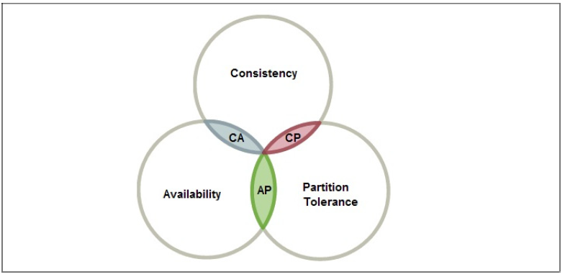
CAP Theorem
Only Two properties at a time can be achieved : Either AP, CA or CP
Notes:
If we opt for CP (consistency and partition tolerance), we sacrifice availability.
If we opt for AP (availability and partition tolerance), we sacrificeconsistency.
If we opt for AC (availability and consistency), we sacrifice partition tolerance.

Slide 36
CAP Theorem
Choice is between consistency or availability as network partition cant be ignored.
Imagine a distributed system with two nodes. Due to partition nodes cant communicate with each other.
Consistency?
Availability?
Partition Tolerance?
Blockchain Manages to achieve all these

Slide 37
CAP Theorem & Blockchain
Consistency is achieved over time as a result of validation from multiple nodes over time.
There can be temporary disagreements between nodes on final state but it is eventually agreed upon.
Ex : Bitcoin
Multiple transaction confirmation required to achieve good level of confidence that transactions are not rolled back in future
Consistent view of transaction history available to all nodes

Slide 38
Decentralization
core benefit and service provided by blockchain technology
allows anyone to compete to become the decision-making authority
consensus mechanism governs this competition, and the most famous method is known as Proof of Work (PoW)
applied in varying degrees from a semi-decentralized model to a fully decentralized one depending on the requirements and circumstances

Slide 39
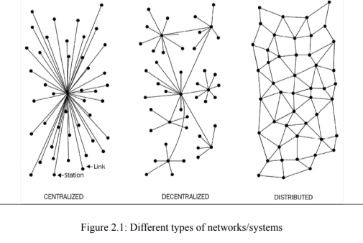
Decentralization
Not dependent on a single master node
control is distributed among many nodes
computation may not happen in parallel and
data is replicated across multiple nodes that users view as a single, coherent System
still a central authority that governs the entire system
majority of online service
providers, including Google, Amazon, eBay, and Apple's App Store, use this model to deliver services

Slide 40
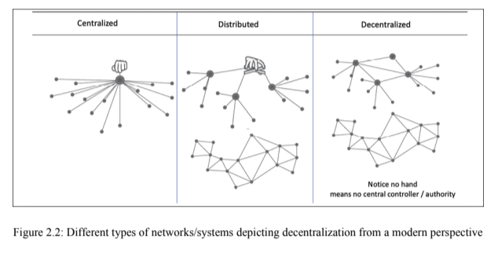
Decentralization

Slide 41
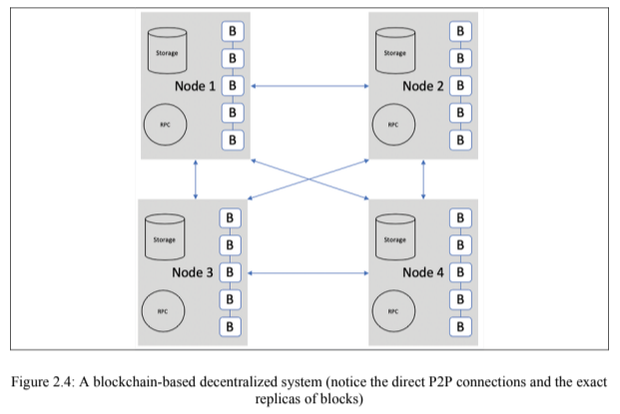
Decentralization

Slide 42
Decentralization
Feature | Centralized | Decentralized
Ownership | Service provider | All users
Architecture | Client/server | Distributed, different topologies
Security | Basic | More secure
High availability | No | Yes
Fault tolerance | Basic, single point of failure | Highly tolerant, as service is replicated
Collusion resistance | Basic, because it's under the control of a group or even single individual | Highly resistant, as consensus algorithms ensure defense against adversaries

Slide 43
Decentralization
Feature | Centralized | Decentralized
Application architecture | Single application | Application replicated across all nodes
Trust | Consumers have to trust the service provider | No mutual trust required
Cost for consumer | Higher | Lower

Slide 44
Methods of decentralization
Two methods - disintermediation and competition
Disintermediation - the intermediary (that is, the bank) is no longer required
used not only in finance but in many other industries as well, such as health, law, and the public sector

Slide 45
Methods of decentralization
Contest-driven decentralization - different service providers compete with each other in order to be selected for the provision of services by the system
ensures that an intermediary or service provider is not monopolizing the service
will not result in full decentralization, but it allows smart contracts to make a free choice based on the criteria just mentioned

Slide 46
Routes to decentralization
Case of a Money transfer system
1. What is being decentralized?
2. What level of decentralization is required?
3. What blockchain is used?
4. What security mechanism is used?
1. Money transfer system
2. Disintermediation
3. Bitcoin
4. Atomicity (ensure that transactions execute successfully in full or do not execute at all)

Slide 47
Blockchain and full ecosystem decentralization
Storage
stored directly in a blockchain which achieves decentralization but is not suitable for large data
better alternative for storing data is to use distributed hash tables (DHTs)
BitTorrent is the most scalable and fastest network

Slide 48
Blockchain and full ecosystem decentralization
There are other alternatives for data storage, such as Ethereum Swarm, Storj, and MaidSafe
Ethereum has its own decentralized and distributed ecosystem that uses Swarm for storage and the Whisper protocol for communication
BigChainDB is another storage layer decentralization project aimed at providing a scalable, fast, and linearly scalable decentralized database

Slide 49
Blockchain and full ecosystem decentralization
Communication
based on the unconditional trust of a central authority (the service provider) where users are not in control of their data
Even user passwords are stored on trusted third-party systems
need to provide control to individual users in such a way that access to their data is guaranteed and is not dependent on a single third party

Slide 50
Blockchain and full ecosystem decentralization
Communication
alternative to ISP is to use mesh networks
provides a decentralized alternative where nodes can talk directly to each other without a central hub such as an ISP
Computing power and decentralization
achieved by a blockchain technology such as Ethereum, where smart contracts with embedded business logic can run on the blockchain network

Slide 51
Questions
Illustrate the blockchain based decentralized system.
Explain how Proof of Stake can achieve consensus among peers.
Illustrate and explain how blockchain works using a neat diagram.
Explain the benefits, features and limitations of blockchain.
Explain consensus mechanisms used in blockchain. List out any six consensus algorithms used in the context of blockchain.
Define blockchain. Explain how decentralization of computing or processing power is achieved by a blockchain.
Explain the fundamental concepts of blockchain technology

Slide 52
Link to additional resources
Bitcoin Script: An Introduction For Beginners (komodoplatform.com)
Ethereum Transactions Information | Etherscan
Ethereum Blocks #0 | Etherscan
Blockchain.com Explorer | BCH | ETH | BCH

